Slide 1
SnapEats
Csc 33600
Fall 2025
Local Restaurant Ordering and Delivery System
Presented By: Fatoumata Drammeh, David Girgis, Qiuming Wang, Xinhang Yang, Md Mamun, Oumar Kante

Slide 2
CSC 33600
Member Roles
Fall 2025
Front End
Back End
1
2
Xinhang Yang
Oumar Kante
Md Mamun
Qiuming Wang
Fatoumata Drammeh
David Girgis

Slide 3
CSC 33600
SnapEats - Business summary
Fall 2025
Problem:
Local Restaurants often lack the digital infrastructure to manage online orders and deliveries efficiently.
Solution:
Create an affordable, centralized system that connect customers, restaurants, and delivery drivers, increasing revenue and operational efficiency.
Concept:
An ordering and delivery platform designed for local restaurants where customers can place food orders online, restaurants manage menus and orders, and delivery drivers track and fulfill deliveries in real-time.

Slide 4
CSC 33600
User Journey
Stage
Discover
Explore
Decision
Commit
Complete
Objective | Finds Delivery site | Browse local restaurants | Choose where/what to eat | Add items to Cart Place Order | Receive food
Needs | Easy signup Clear Purpose | Search Filter | Review Menus Prices Delivery Time | Secure Checkout | Real-time tracking
Feeling | Curious Hungry | Interested | Confident | Excited | Satisfied
Pain Points | Slow service Slow process | Too many options | Missing Info Unsatisfied with options | Payment Issues | Late delivery
Opportunities | Simple landing page | Personalized per location | Show all info Easy backout | One Click checkout | Notification updates

Slide 5



Front End Tech Stack
CSC 33600
Fall 2025
React allows developers to create reusable components, manage data efficiently, and update web pages quickly without reloading the whole site.
Vite is a modern build tool and development server for React.It provides lightning-fast startup, hot reloading, and optimized performance during development.
CSS controls the look and layout of our website. It defines colors, fonts, spacing, and how the page adapts to different screen sizes.
Axios is a JavaScript library used to connect our React frontend with the Flask backend.
It allows us to send and receive order data in real time through RESTful APIs.

Slide 6






CSC 33600
Full Tech Stack
1
2
3
4
Fall 2025
Front End
Back End
Database
Collaboration Tools

Slide 7
CSC 33600
Use Case 1 – Creating an Order
Fall 2025
🎯 Goal:Let the customer place an order successfully.
🧍‍♀️ Actor: Customer
🪜 Steps:
The customer logs in and selects a restaurant.
They browse the restaurant’s menu.
The customer adds items to the cart and reviews it.
They confirm and proceed to payment.
The system displays an order confirmation message.
⚙️ System Interaction:
React frontend sends order details to the Flask backend through Axios.
Flask stores the order data in the MySQL database.
Backend returns confirmation to the frontend to update the UI.

Slide 8
CSC 33600
Use Case 2 – Browsing Restaurants & Menus
Fall 2025
🎯 Goal:Let the customer browse available restaurants and their menus.
🧍‍♀️ Actor: Customer
🪜 Steps:
The customer logs in and sets their location.
The system displays a list of restaurants nearby.
The customer selects one restaurant to view its menu.
Menu items, descriptions, and prices are shown dynamically.
The user can continue browsing or add items to their cart.
⚙️ System Interaction:
The React frontend requests restaurant data from Flask API.
Flask queries the MySQL database and returns results in JSON format.
React renders the restaurant list and menu on the page.

Slide 9
CSC 33600
Use Case 3 – Creating an Order
Fall 2025
🎯 Goal:Let the customer place an order successfully.
🧍‍♂️ Actor: Customer
🪜 Steps:
The customer logs in and selects a restaurant.
They browse the restaurant’s menu.
The customer adds items to the cart and reviews it.
They confirm and proceed to payment.
The system displays an order confirmation message.
⚙️ System Interaction:
React frontend sends order details to Flask backend.
Flask backend stores data in MySQL database.
The backend returns confirmation to the frontend.

Slide 10
CSC 33600
Use Case 4 – Canceling an Order
Fall 2025
🎯 Goal:Allow the customer to cancel an order before it’s accepted by the restaurant.
🧍‍♂️ Actor:Customer
🪜 Steps:
The customer opens “My Orders” page.
They select an active order.
Click “Cancel Order.”
The system updates the order status to “Canceled.”
The updated status appears instantly on the frontend.
⚙️ System Interaction:
React sends a cancel request to Flask API.
Flask updates the order status in the database.
Frontend re-renders with the new order state.

Slide 11
CSC 33600
Use Case 5 – Tracking an Order
Fall 2025
🎯 Goal:Allow customers to monitor their delivery status in real time.
🧍‍♂️ Actor:Customer
🪜 Steps:
The customer opens the “Order Tracking” page.
The frontend displays the current delivery status (e.g., Preparing, Out for delivery, Completed).
Status updates automatically as the backend changes the order stage.
Once completed, the app shows “Order Delivered” and an option to rate the restaurant.
⚙️ System Interaction:
Frontend fetches order status updates through API polling or WebSocket.
Backend sends real-time updates from the delivery database.
Frontend displays live progress to the user.

Slide 12
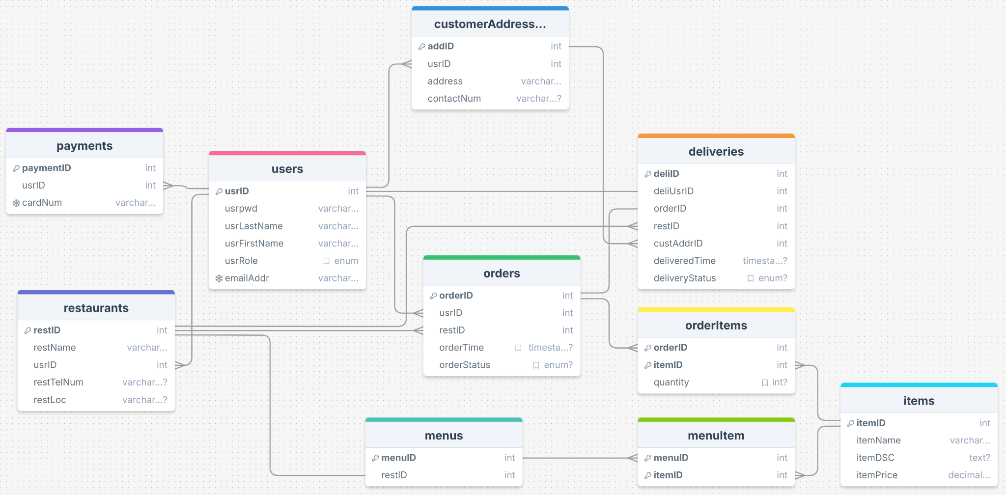
CSC 33600
Relational Data Model (2NF)
Fall 2025

Slide 13
CSC 33600
Any questions?
Ask away!
Fall 2025

Slide 14
Thank you

